Slide 1

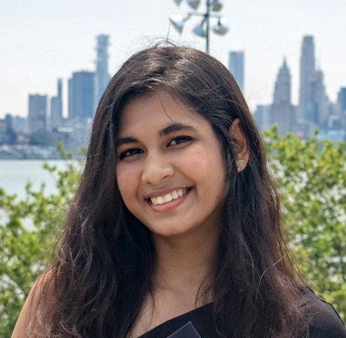


About Me
Quick snapshot — who I am, what I do, and what I bring to the team
Background
Insert
Photo
Education: Master of Project Management (Northeastern University ; BA Business Management (NJCU & Somaiya Vidyavihar)
Experience: 1 years across Product & Project Management / Function — list 1-2 prior areas
Certifications: CAPM, CSPO, CSM, Six Sigma Yellow belt
Current Role & Responsibilities
Ishwari Dhamdhere
Lead Safeguard project specifications and document control activities — accountable for [primar
Drive [key initiative or program] across [scope: site, division, enterprise]
Partner with [stakeholders] to deliver [business result]
Quality Assurance Project Specialist
LOCATION
Columbus, Ohio
TENURE
3 months in Abbott
Outside of Work
MANAGER
Anthony Scimeca
Family: Family Lives in India
Hobbies & Interests:
Fun fact: ]
TOP STRENGTH
Interpersonal and Emotional intelligence skills
Career Development • Confidential
1 / 5

Slide 2
My Career Journey
Key roles, milestones, and moments that shaped my path
2025
[YEAR]
Today
Associate Proj
[Role Change]
Podimetrics •
[Company / Function]
2023
[YEAR]
2026
Masters in Project Management
[Key Milestone]
Joined Abbott
Northeastern University
[Award • Cert • Project]
Abbott • GSQA
Tip: Add or remove milestones as needed. Highlight the moments where you grew the most — not just titles, but learning experiences, awards, projects, or pivots.
Career Development • Confidential
2 / 5

Slide 3



Where I'm Headed
My short-term and long-term aspirations, and the experiences I want to gain
Short-Term Aspiration
Long-Term Aspiration
Areas of Interest
Next 12-24 months
3-5 years out
Functions, divisions, geographies
Target Role: [Role / Level]
What I want to do:
[Type of work, scope, leadership level]
Why now:
[What you'd learn, how it builds on current strengths]
Skills I need to build:
[1-2 specific capabilities to grow]
Target Role: [Director / VP / Functional Leader]
Vision for my career:
[The kind of leader / contributor you want to be]
Impact I want to drive:
[Customers served, problems solved, teams built]
What success looks like:
[How you'll know you've gotten there]
Functions:
[e.g., R&D, OpEx, Quality, Commercial]
Divisions / Businesses:
[e.g., Nutrition, Diabetes Care, Diagnostics, EPD]
Mobility / Geography:
[Open to relocation? Domestic / international?]
Curiosities to explore:
[Areas you'd like to learn more about]
Experiences I want to gain to get there:
[e.g., people leadership, P&L ownership, cross-functional rotation, M&A integration, global assignment, customer-facing role]
Career Development • Confidential
3 / 5

Slide 4

My Strengths & How I'll Grow Them
Top 5 CliftonStrengths and the actions I'll take in 2026 to expand them
"The most effective leaders are always investing in their strengths." Identify them, sharpen them, and create deliberate opportunities to use them.
Strength #1
Strength #2
Strength #3
Strength #4
Strength #5
[Strength Name]
[Strength Name]
[Strength Name]
[Strength Name]
[Strength Name]
[Domain]
[Domain]
[Domain]
[Domain]
[Domain]
[How I use it on the team]
[How I use it on the team]
[How I use it on the team]
[How I use it on the team]
[How I use it on the team]
2026 Development Plan — Activities to Advance or Expand My Top Strengths
1
Activity: [e.g., Lead a cross-functional improvement project this quarter]
Strength it builds: [Which strength + how it stretches you] | By when: [Date / Quarter]
2
Activity: [e.g., Take an executive education or certification course]
Strength it builds: [Which strength + how it stretches you] | By when: [Date / Quarter]
3
Activity: [e.g., Mentor a peer or stretch outside your current function]
Strength it builds: [Which strength + how it stretches you] | By when: [Date / Quarter]
Career Development • Confidential
4 / 5

Slide 5




My Support System & Learning Plan
Mentors, sponsors, certifications, and learning that will fuel my growth
Mentors
Sponsors & Advocates
People I learn from regularly — formal or informal
Leaders who advocate for me when I'm not in the room
Name
Focus area
Cadence
Current sponsors:
[Name — Role / Why they sponsor me]
[Name — Role / Why they sponsor me]
Sponsors I want to build a relationship with:
[Name / Role + how I will create exposure]
[Name / Role + how I will create exposure]
Chris Jones
[e.g., Leadership presence]
Monthly
[Mentor 2]
[e.g., Technical depth]
[Quarterly]
[Mentor 3]
[e.g., Career navigation]
[As needed]
[Mentor 4]
[Wish-list mentor — pursue]
[TBD]
Certifications & Credentials
Learning & Reading
Hold today:
CAPM, CSPO, CSM, Six Sigma Yellow Belt
Pursuing in 2026:
PMP
[Cert / Credential — Target completion]
On the radar:
[Future credentials to consider]
Courses / Programs:
[Abbott internal program — name + status]
[External course / executive education]
Books / Podcasts I'm working through:
[Title — Author / Host]
[Title — Author / Host]
Career Development • Confidential
5 / 5

